Slide 1
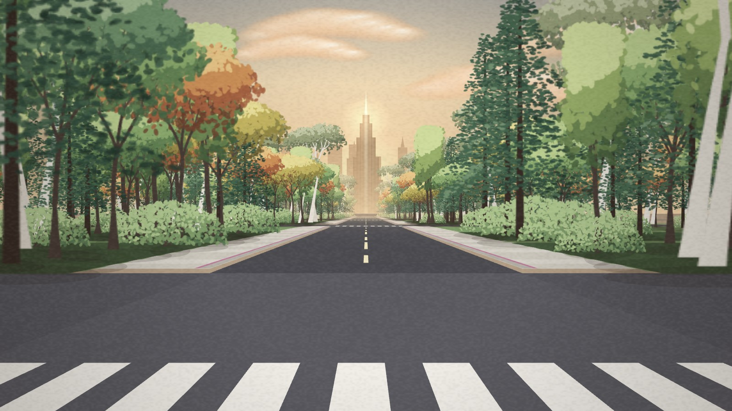
A2B · GENERATIVE LANDSCAPE
We Build Our World
Everything here is forest. Make it the world you want. · Hedy Tan
Notes:
Hi, I’m Hedy. My project is We Build Our World, an interactive generative landscape made in p5.js. What you see here is where every visit starts: a street, and on both sides of it, forest. Nothing is built yet. In the next five minutes I’ll show you the idea, how your body becomes the tool that changes this place, how the world answers back, and the technical work underneath it. Then a short clip of a full run.

Slide 2
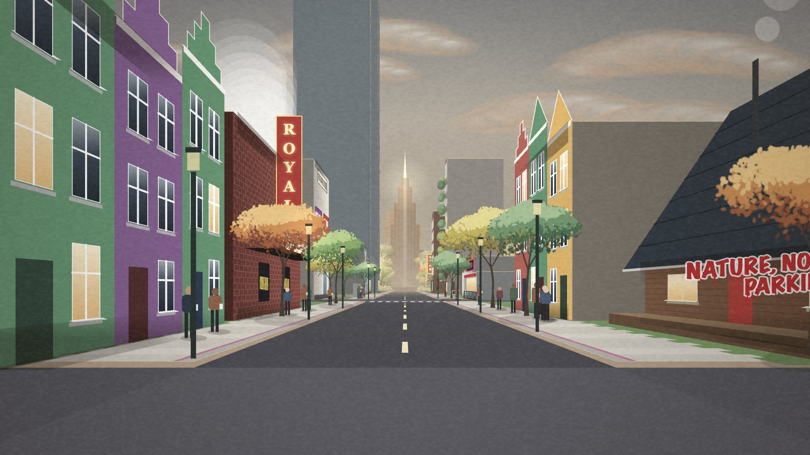
Every city was a forest once
WHERE YOU START
WHAT YOU MAKE OF IT
You walk a street that is still forest. With your own hands you cut it down and lift the city you want. Nothing stops you, and the world quietly keeps score. Made for anyone who has watched the forest at the edge of their town disappear under new buildings.
Notes:
The concept in one line: every city was a forest once, and we build our world the way we want it. The person in front of the screen is the developer. You start on the left image: a street lined with painted forest, birdsong, warm light. You end wherever you choose to stop, often somewhere like the right image: towers, car parks, a grey sky. The work never tells you you’re doing something wrong. There is no score to win and no warning. It simply lets you build, and makes sure you notice what that costs. The objective was to make the cost of development something you feel through your own actions, rather than something you read on a sign. It is made for anyone who has watched the forest at the edge of their town disappear under new buildings: people who live in growing cities, students, gallery visitors. You need no instructions and no gaming skill, just your hands.

Slide 3
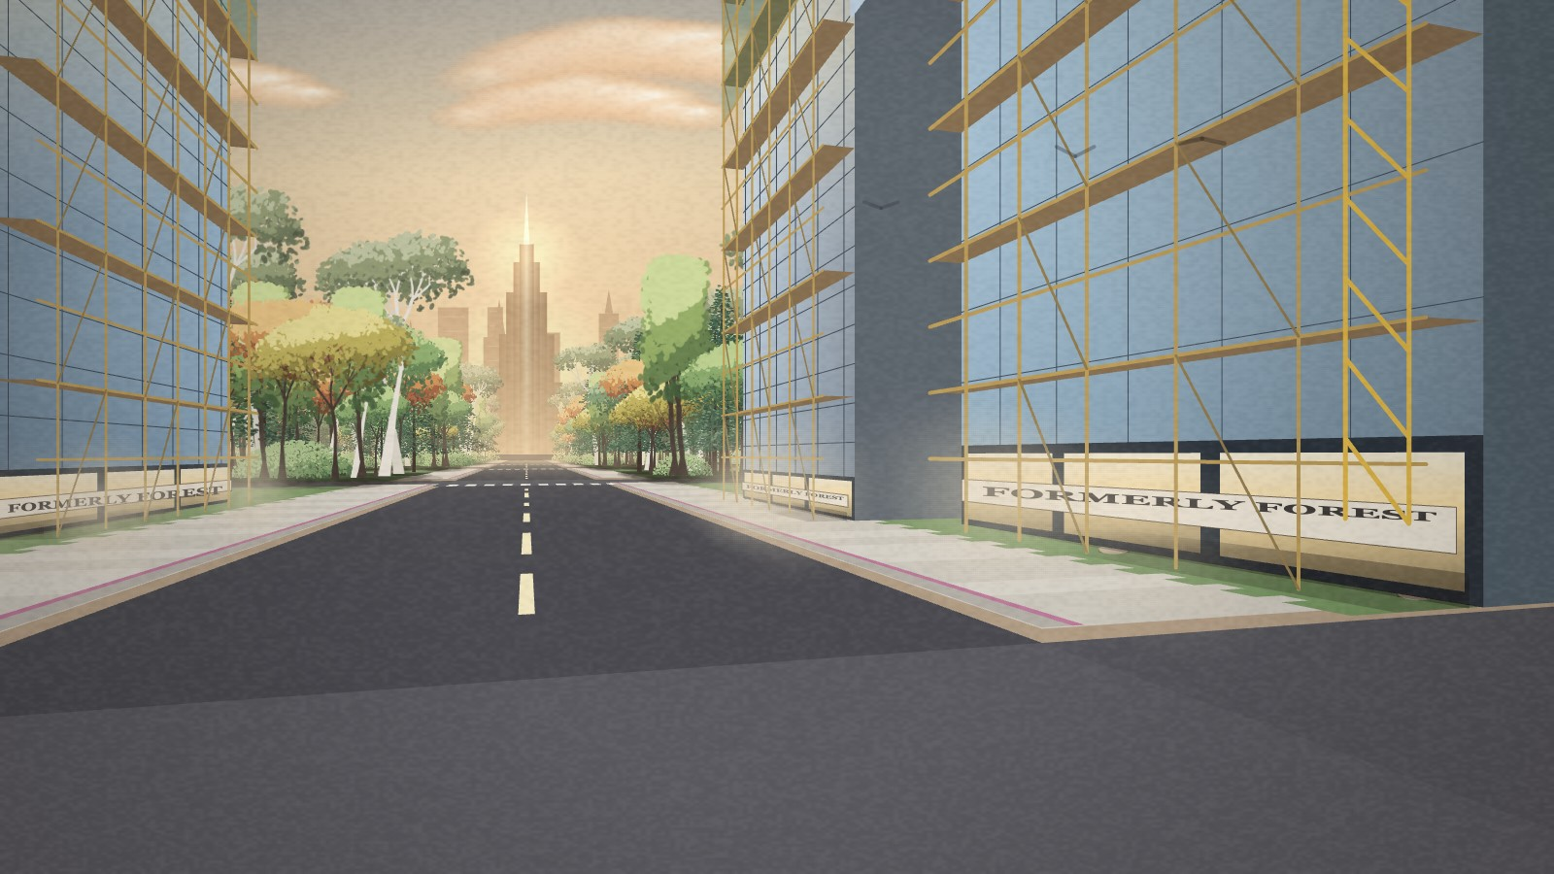
Your body is the tool
You… | It… | Which says…
Swing an arm | Cuts the forest on that side | Clearing land takes one swing
Lift one finger | Homes: cabin → row houses → green condos | The higher you reach, the more you take
Lift an open hand | Diner → cinema, supermarket → mall | Every need becomes a building
Lift a fist | Car park → power station → empty tower | “Forest View Apartments”, nobody home
Walk on the spot | Moves you down the street | The change follows you
Buildings rise floor by floor under your hand, with scaffolding and a crane.
A NEXT bar always says what to do. A camera panel shows what each hand will build. Keys work too: arrows, H, S, B.
Notes:
The interaction carries the meaning. I use ml5 hand tracking on the webcam, and every gesture was chosen for what it says. Cutting the forest is a single swing of the arm: it should feel too easy. Building is lifting: the higher you reach, the bigger the building, so greed is literally a reach upward. The shape of your hand picks what you build: one finger makes homes, from a log cabin to colourful row houses to condos with trees on the balconies; an open hand makes shops, from a diner to a cinema to a mall called Forest Plaza; a fist makes industry: car parks, substations, power stations, data centres and towers that stand empty, with names like Forest View Apartments. And you move by walking on the spot, so the whole body is involved, and you can keep cutting and building while you walk. Each hand works its own side of the street: your right hand the right, your left hand the left. The interface stays out of the way but you are never lost: a NEXT bar at the top always tells you the one thing to do now, the camera panel shows where your hands are and what each will build, the camera calibrates itself when it starts, and every gesture has a keyboard key as a backup: the arrow keys cut, and H, S and B build homes, shops and towers, with the same mix of sizes as the hands.

Slide 4
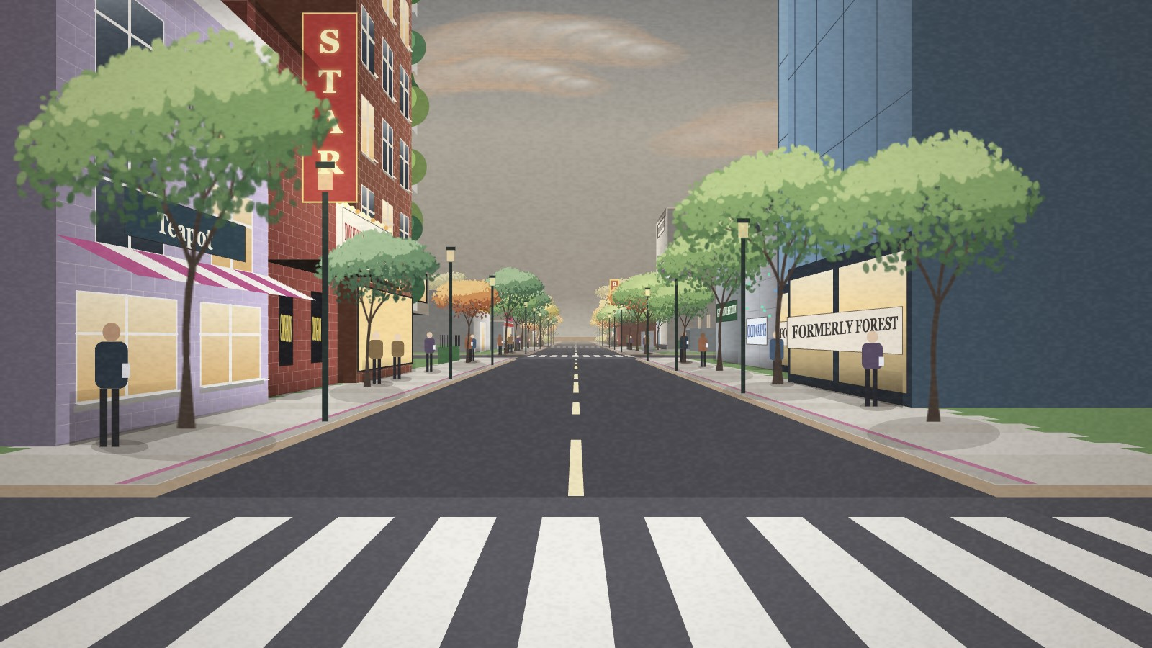
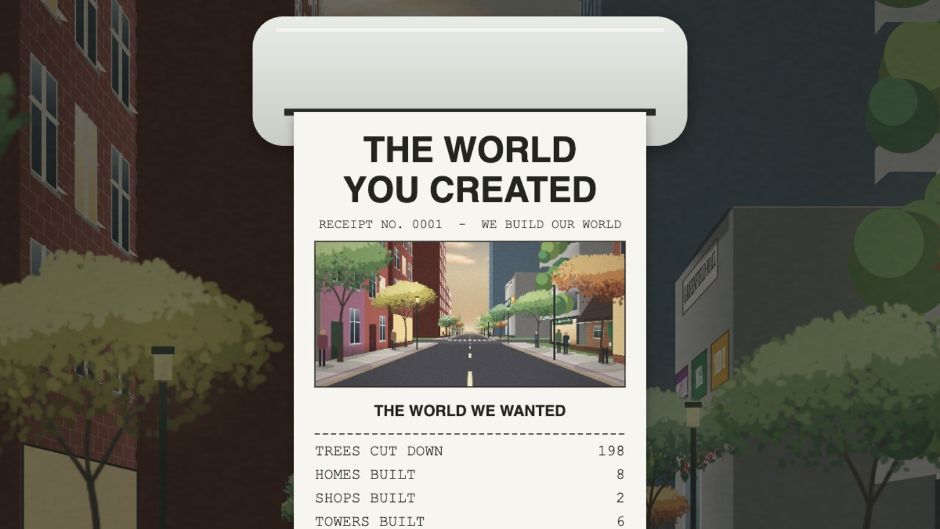
The world answers back
Light and air
Look back
The receipt
Warm golden light turns flat and grey. Every factory adds smog.
Press T and turn round: the street behind you is what you made.
Press F: a printer prints what it cost. Paid by: the forest.
Sound follows too: wind and birdsong fade into traffic, and strings and harp give way to pop, then a house beat.
Notes:
Every action is answered, so you feel the consequence without being told. Visually: in the forest the light is warm and golden. As the street fills, every building, especially factories and power stations, adds smog, the sky and the haze turn grey, and the colour of the street goes flat. When you chop, birds burst out of the trees and fly away. You can press T at any time to turn round and look at the street behind you. When you decide you’re finished, a little printer prints a receipt: The World You Created, a snapshot of the street you built, how many trees, homes, shops and towers, and at the bottom, paid by: the forest. And then: listen, the birds have stopped. The sound does the same journey: it starts with wind, leaves and birdsong and a slow strings-and-harp piece, and as you build the wild sounds fade, traffic rises, and the music changes to pop and then a city house beat.

Slide 5
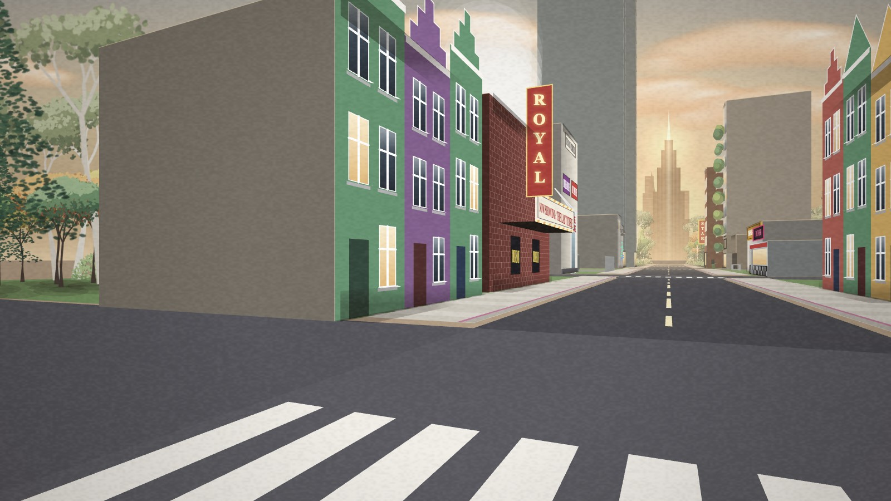
How it works
It sees your hands
It feels you walk
The webcam finds both hands and reads their shape: one finger, an open hand or a fist.
Step on the spot and the camera sees you move, so the street moves with you.
A painted street
Trees made by code
Drawn flat like an illustration, but it feels like walking down a real street.
Each tree grows branch by branch, then is painted in hundreds of little leaf strokes.
24
kinds of building, from a log cabin to a power station
Buildings made by code
Sound made by code
Every building is drawn by the program and picked at random, so no street repeats.
Birds, wind, the axe and the music are all created live as you play.
12
0
kinds of tree
photos or recordings
Tidy code: small files with one job each, clear notes and a guide. Fast: I found the slowest step and made every frame twice as quick.
Notes:
Here is how it works, in simple terms. First, it sees your hands: the webcam finds both of your hands and reads their shape, one finger, an open hand or a fist, using a hand-tracking tool called ml5. Second, it feels you walk: when you step on the spot, the camera notices the movement and the street moves with you. The street itself is drawn flat, like an illustration, but a virtual camera makes it feel like you are walking down a real street. Nothing in it is a photo or a recording. The trees are grown by the program, branch by branch, and painted in hundreds of little leaf strokes. There are 24 kinds of building, from a log cabin to a cinema to a power station with steaming towers, all drawn by the program and picked at random, so no two streets are the same. And all the sound, the birds, the wind, the axe and the music, is created live by the computer as you play. The code is split into small files that each do one job, with notes explaining it and a guide for anyone who opens the folder. And it runs smoothly: I measured where the time goes in each frame, found that mixing colours took almost half of it, and rewrote that part, so every frame now takes about half the time, with exactly the same picture.

Slide 6
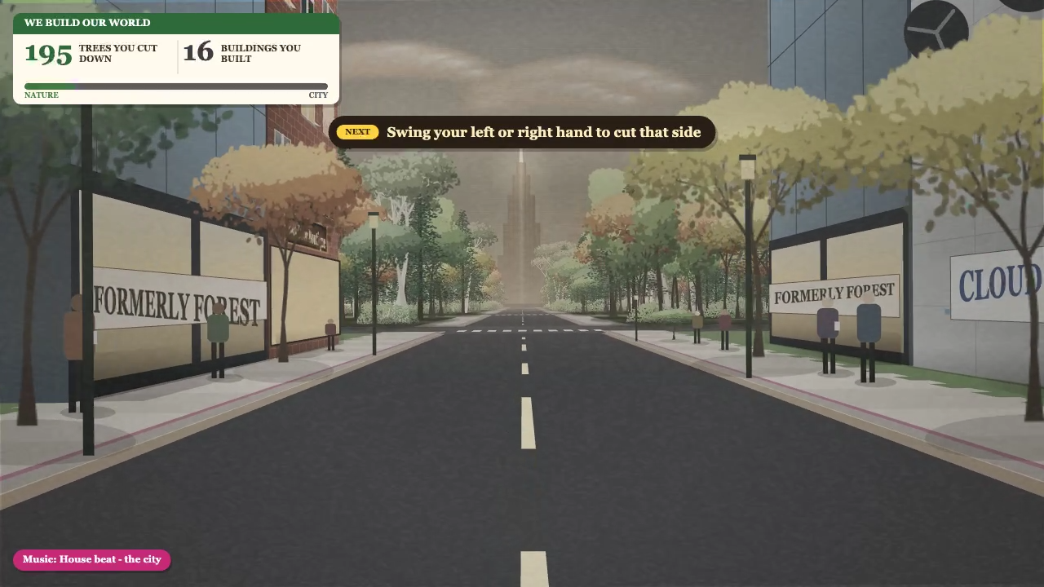
Demo video
Objectives and impact
The meaning is in the moves: cutting is a swing, building is a reach.
Every choice is answered in light, air and sound, so the cost is felt, not read.
No goal to win. You decide when it is enough.
Live: hedytan.github.io/plotline_interative-media/build · Code: we-build-our-world-code (README inside)
Notes:
How does it meet my objectives? First, the meaning is in the moves: you don’t need to read anything, cutting is a swing and building is a reach. Second, the cost is felt, not read: every choice is answered in light, air and sound, and the receipt at the end says who paid: the forest. Third, there is no goal to win: the work hands you the question of when it is enough. The impact I hope for: people walk away a little more aware of what was there before the buildings, and next time they see a forest cleared for a new estate, they remember that it only took one swing. The video is a backup recording of a full walk, from the forest to a grey city and the printed receipt, in case the live demo fails. I’m happy to take questions.

